Slide 1
Taste of Busan
202255661 Hyeyeon Park

Slide 2
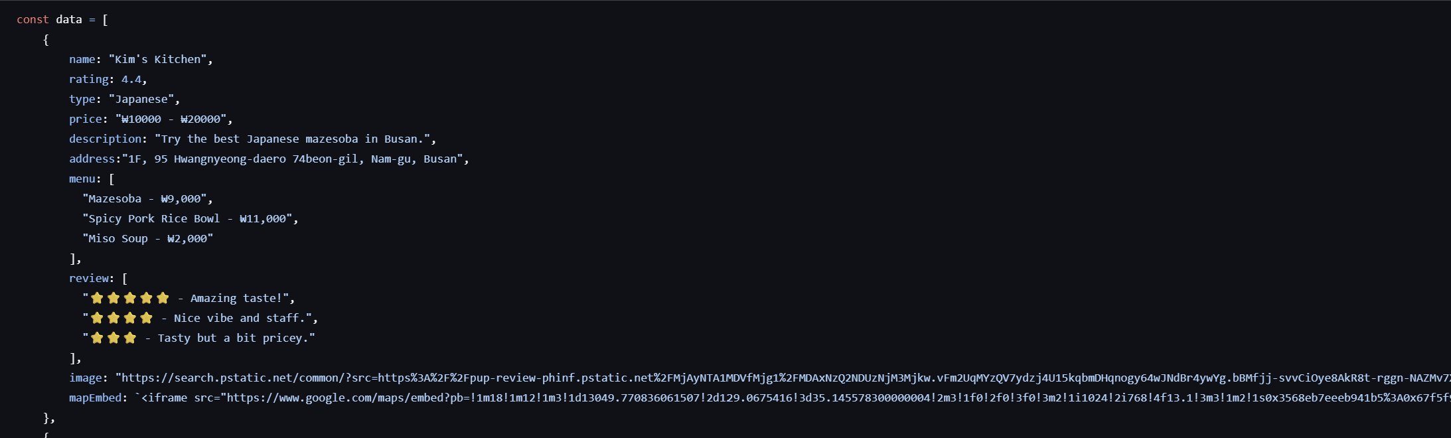
Data
Name, rating, type, image, price, address, description, menu, review, map embed
Name, rating, type, image -> for the main card.
price, description, address, menu, review, image map embed -> for detail page.

Slide 3
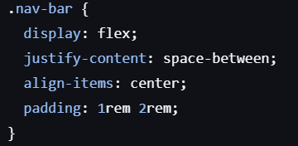
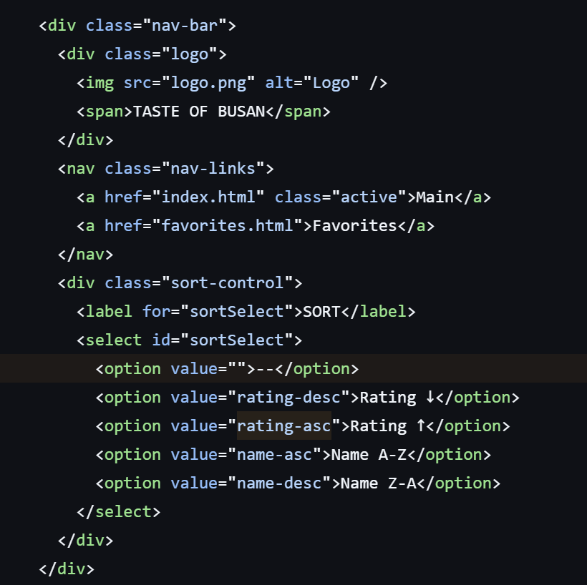
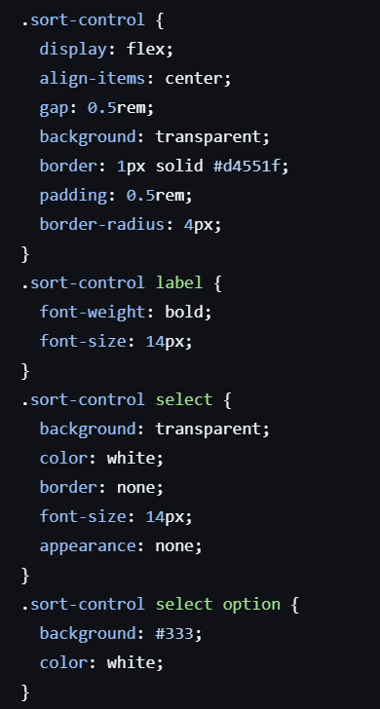
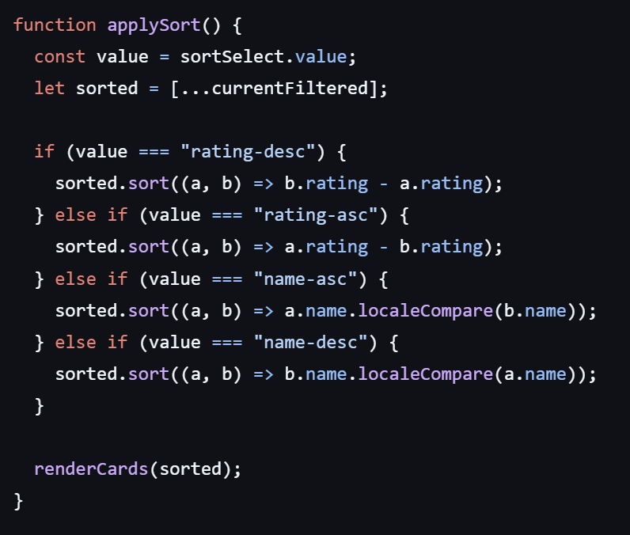
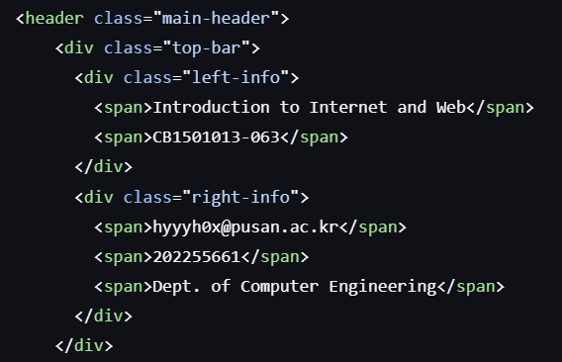
Header -> shows my name and student number, navigation bar and the main title of the page. Also includes sort dropdown.
Sort by names, and ratings.
Css code
Html code for navigation-bar
Js code for sorting.
Html code for main header

Slide 4

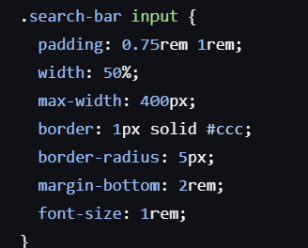
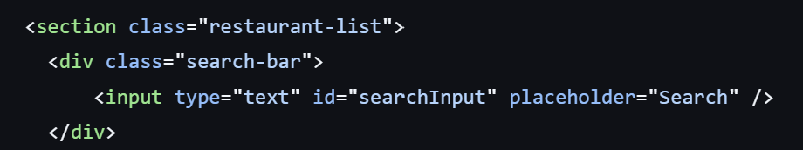
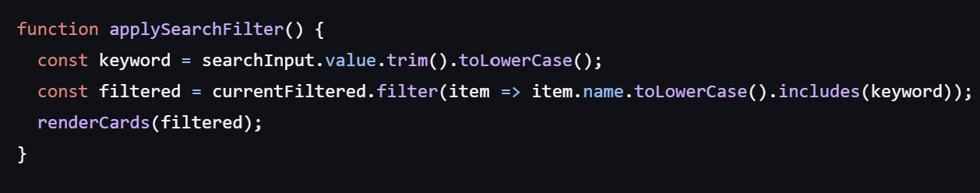
Search bar (search by names)
Css code
Html code for
Search bar
js code for
Filtering names

Slide 5
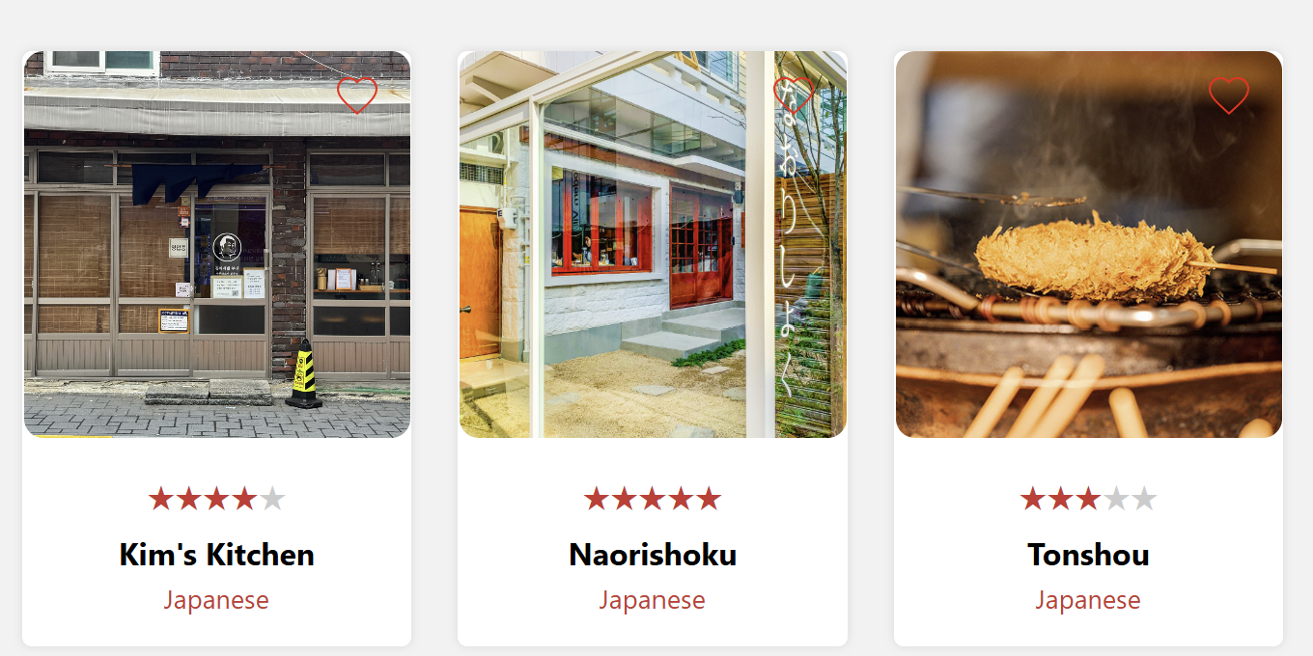
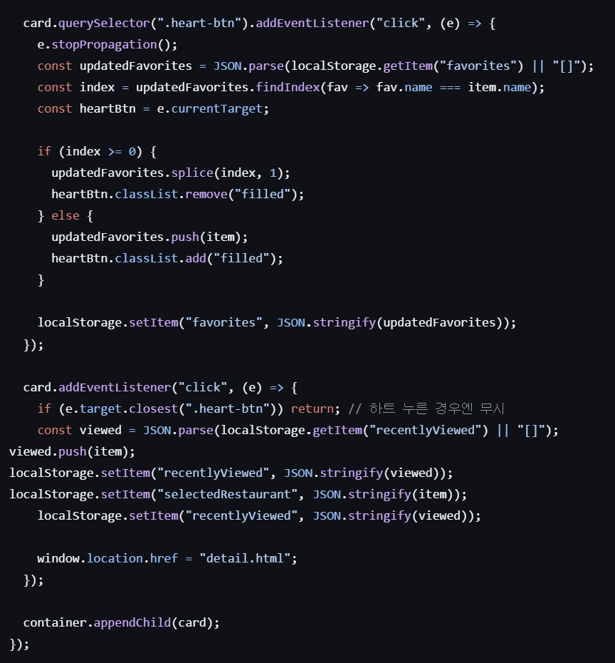
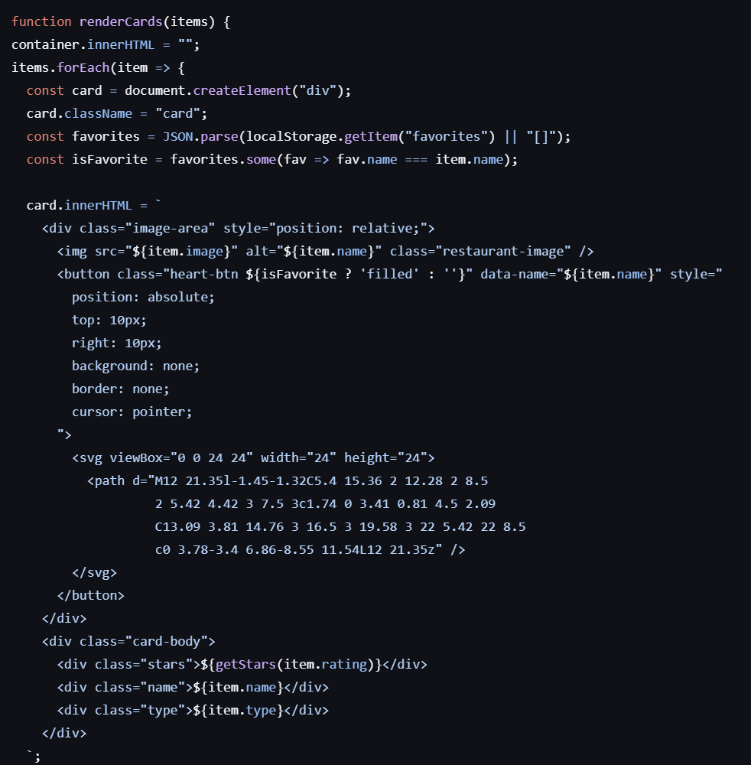
Cards(and heart button)
Js code for heart-button
Js code to show cards
Js code when clicking(goes to detail page)
html code

Slide 6
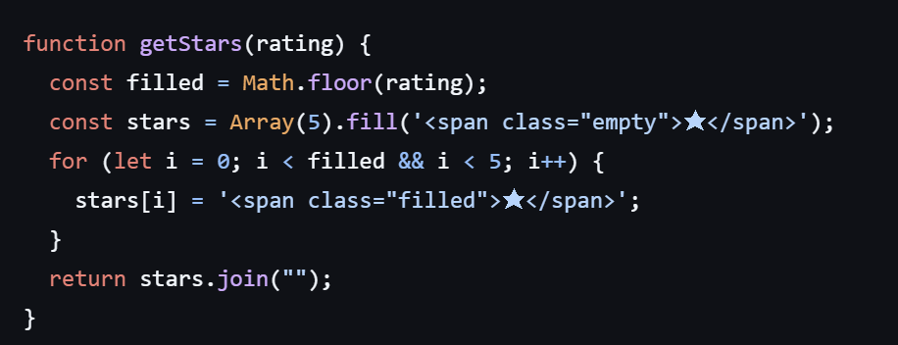
Stars in the cards
Round down the stars and shows as
one, two, three, four, five stars.
For example, If between 4-5, shows 4 stars.
Js code to show stars

Slide 7

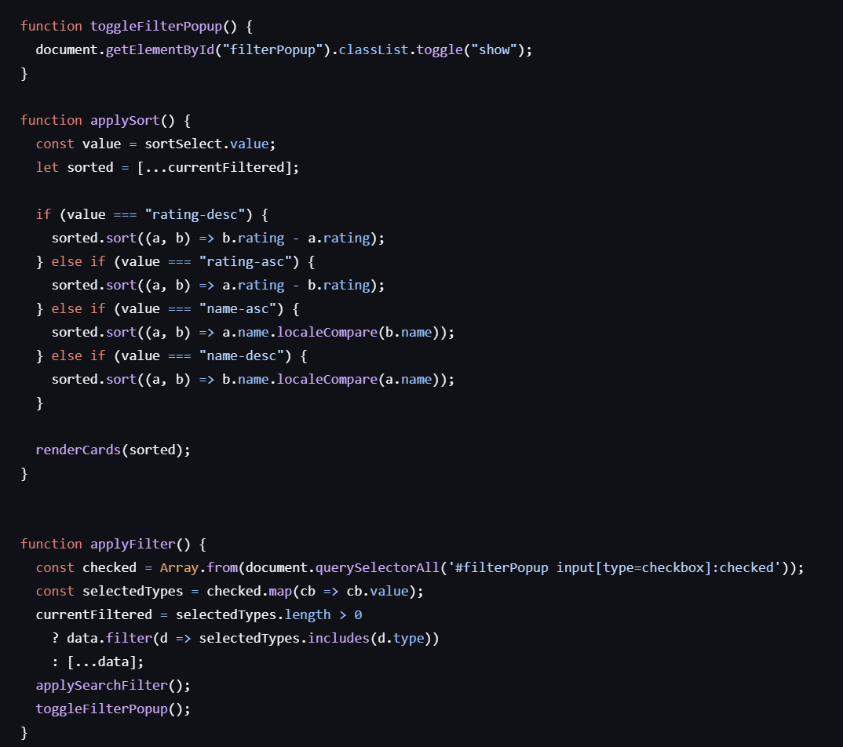
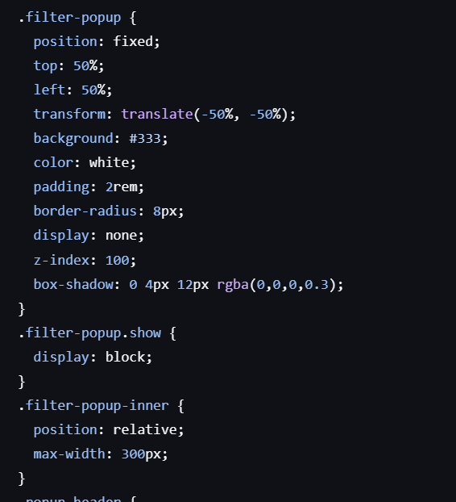
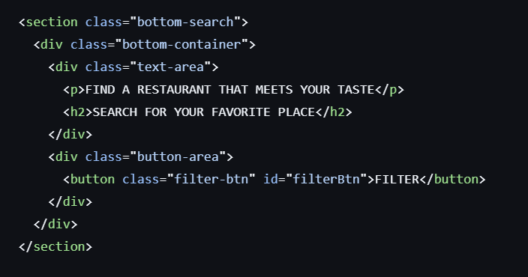
Js code to toggle popup, and apply filter.
Filter button(cuisine types)
Css code
Html code to show filter button

Slide 8
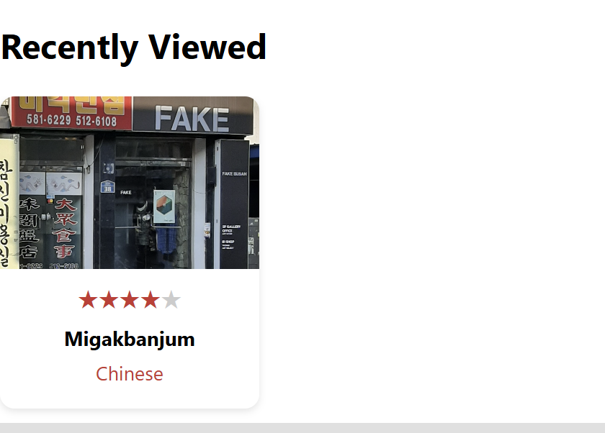
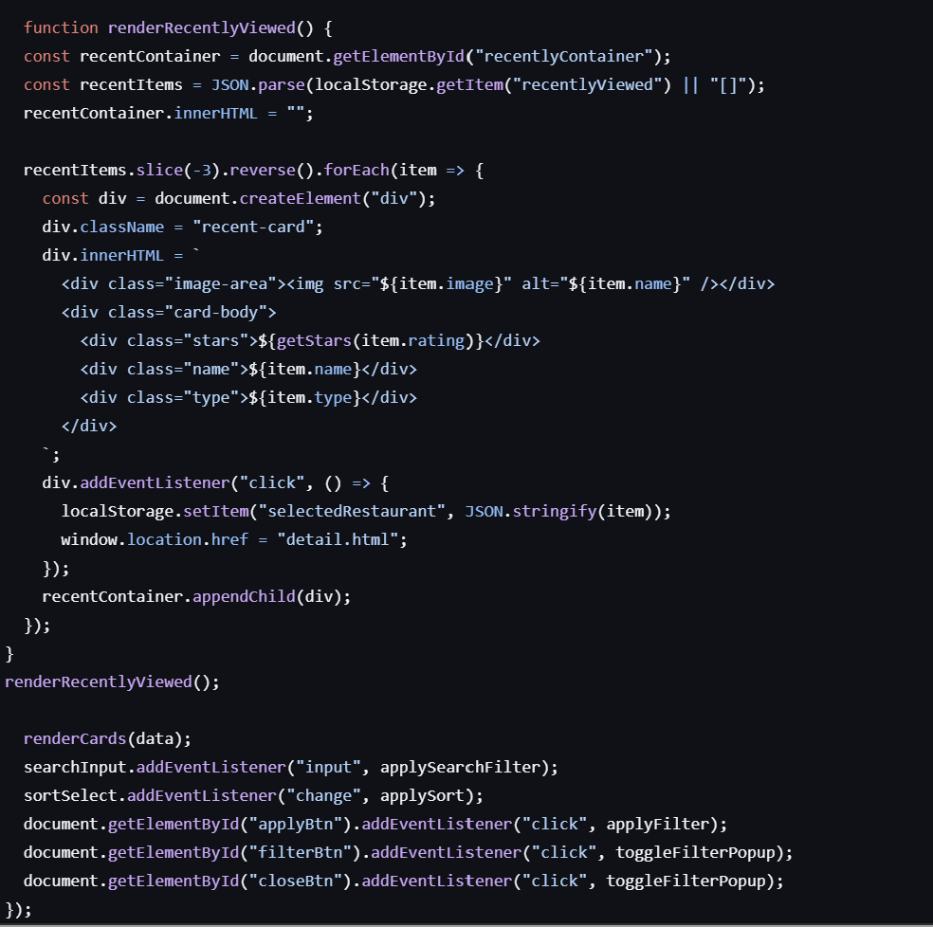
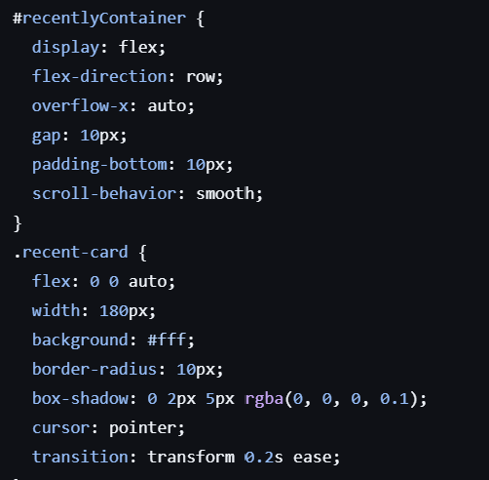
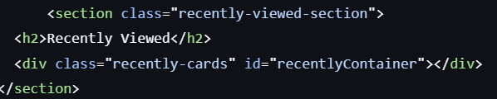
Recently viewed
Js code to show recently viewed restaraunts.
Css code
Html code

Slide 9
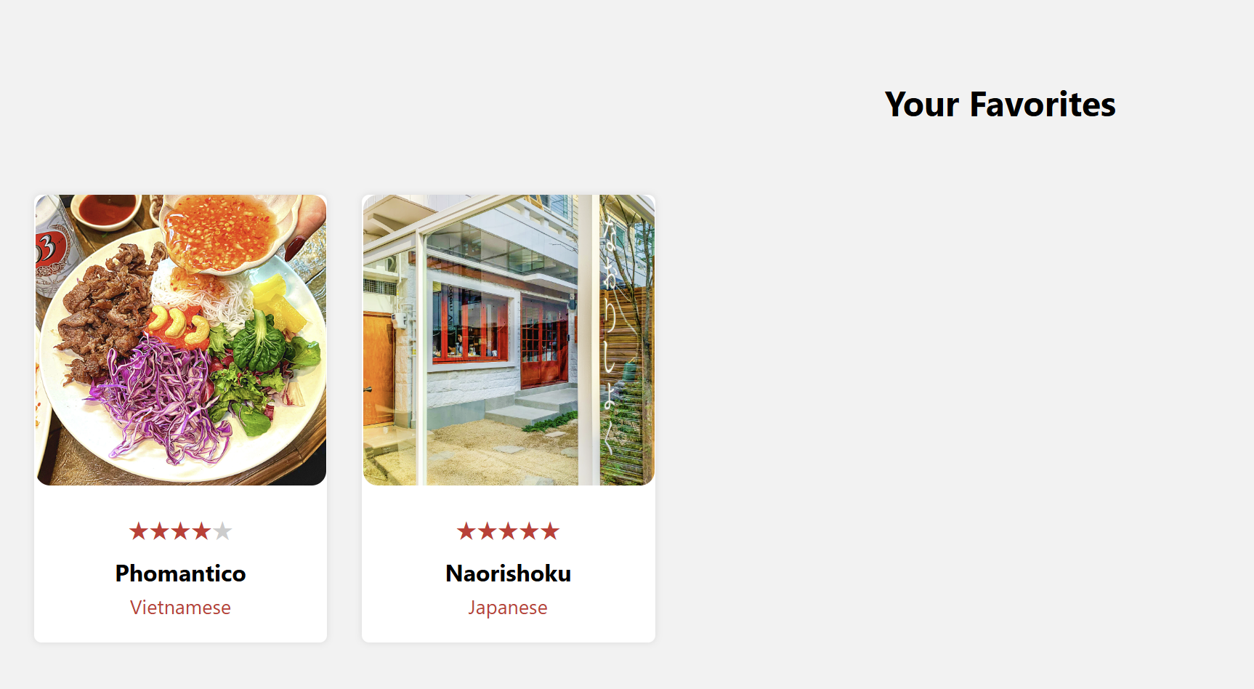
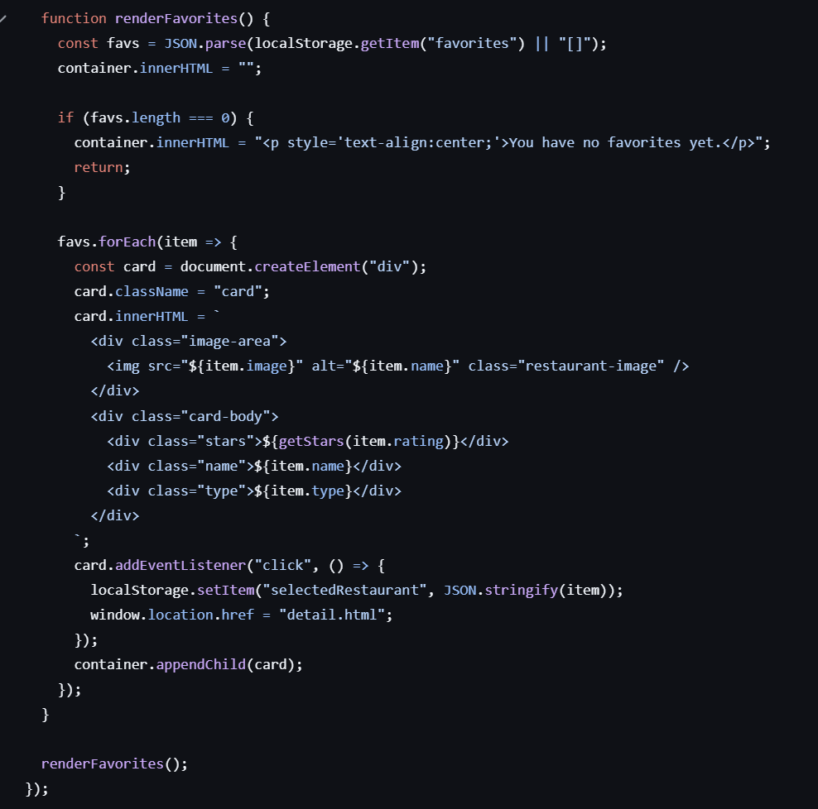
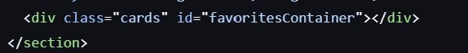
Favorites
Js code to show favorites
Html code

Slide 10
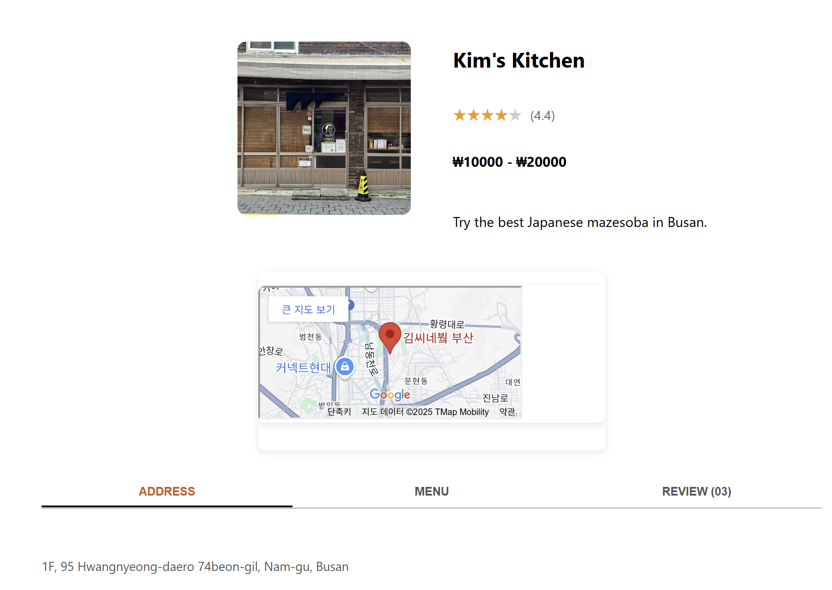
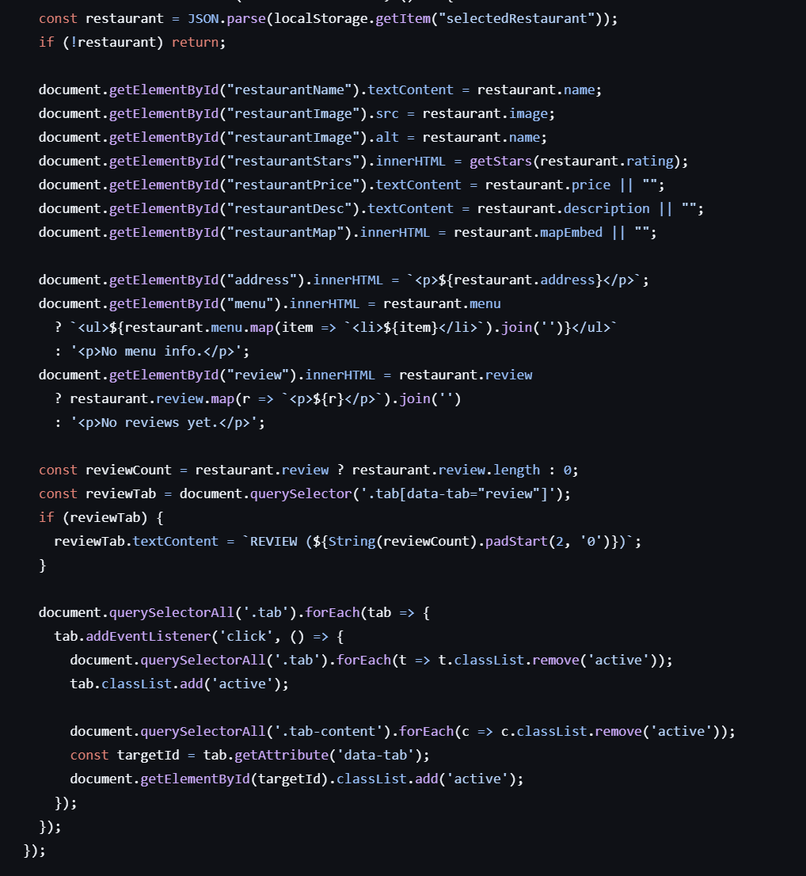
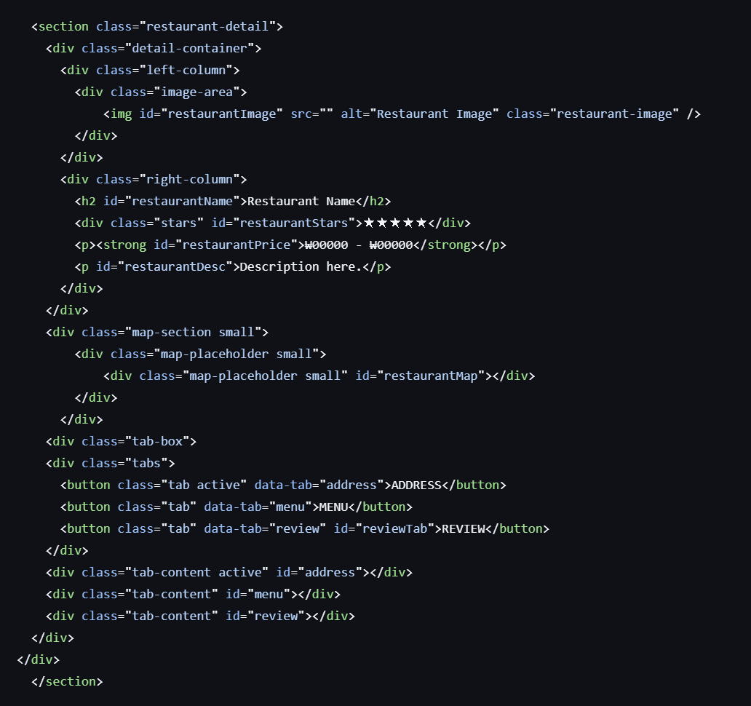
Detail page
Map
Address
Menu
review
Js code to show details
Html code

